Slide 1
Plasma Deposition and Plasma Etch at Tyndall National Institute
Brendan O’Neill
Central Fabrication Director
Alan Blake
Process Engineer
Silicon Fabrication

Slide 2
Plasma Systems
Three plasma deposition systems in various laboratories
  Silicon Fabrication
  Compound Semiconductor Fabrication
  Microsystems Fabrication

Slide 3
Trikon Delta 201
Silicon Fabrication laboratory, versatile system depositing:
  Silane Oxides
  TEOS Oxides
  Doped Oxides , PSG BPSG
  Silicon Nitride
  Oxynitrides

Slide 4
CMOS Cross-Section
Metal 2
Metal 1
Interlevel Dielectric
TEOS
Interlevel Dielectric
BPSG
Field Oxide
P- Well
N- Well
Polysilicon
P-Channel Device
P+ S/D
N+ S/D
N-Channel Device

Slide 5
Novel Application
UK Company, Farfield Sensors
Idea, initially for moisture in gas detector
Using a waveguide system that guides the light through layers of deposited oxide of varying refractive index
Very tight control needed on the RI

Slide 6
Device Structure
Layer 0: Substrate: Silicon wafer thickness 0.525 ± 0.025 mm.
PECVD Silicon Oxynitride Layers
Layer 1: Lower Cladding: 2 ±0.1μm thick, RI 1.485±0.005
Layer 2: Lower Guide: 1 ±0.05μm thick, RI 1.52±0.005
Layer 3: Central Cladding: 3 ±0.1μm thick, RI 1.47±0.002
Layer 4: Top Guide: 1 ±0.025 μm thick, RI 1.52±0.002
Layer 5: Top Clad/Window: 2 ±0.1μm thick, RI 1.47±0.005
Layer 5
Layer 4
Gases Used
SiH₄ and N₂0
N₂0 held constant, SiH₄ varied to change
Refractive Index
Layer 3
Layer 2
Layer 1
Layer 0

Slide 7
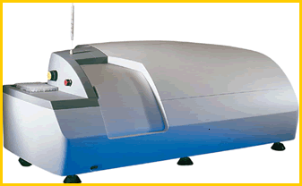
AnaLight® Bio200
Utilises polarised laser light down a wave guide
Evanescent field “interrogates” biological layer
Resulting optical interference allows real-time analysis of protein behaviour
Gives information on; density, dimensionality and orientation of layers

Slide 8
System Schematic

Slide 9
System Operation
Farfield Image shifted
Through the top wave
Interaction with the
Deposited material

Slide 10
Summary
System marketed worldwide
System has won NPL Award for “Innovative Measurement”
Tyndall the only supplier of the interferometer “chip”
Company has grown to annual exports of greater than £1m in less than 2 years

Slide 11
Tyndall National Institute:
Plasma Etch Process Equipment
Silicon CMOS Fabrication
  Drytek TRIODE (RIE)
    Single-chamber silicon & dielectric etch
  Drytek QUAD (RIE)
    4-chamber cluster (metals, silicon/polysilicon, dielectrics & resist strip)
  TRIKON M0RI (Helicon)
    Single chamber silicon & dielectric etch
Silicon Microsystems Fabrication
  STS Multiplex (ICP)
    Single-chamber deep-trench etch (silicon & dielectrics)
III-V Fabrication
  STS Multiplex (ICP)
    Single-chamber III-V & dielectric etch

Slide 12
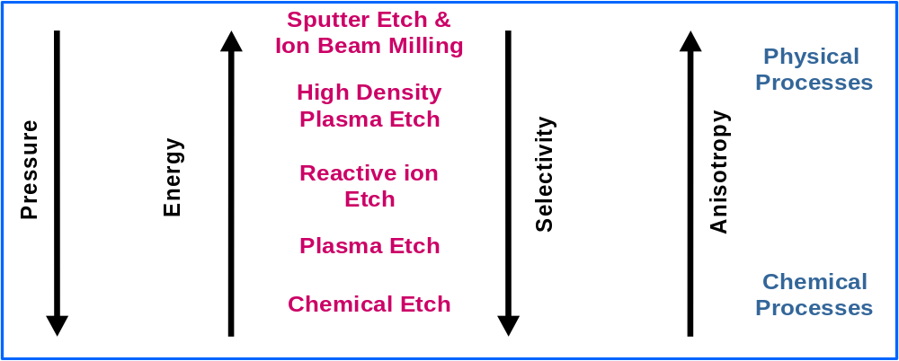
Plasma Etch Process Parameters

Slide 13
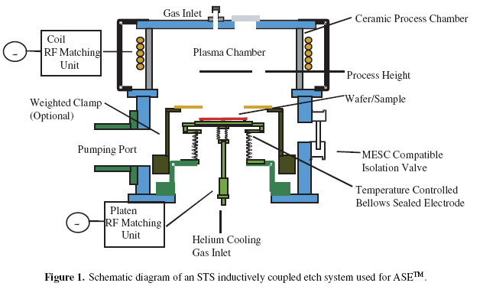
STS Multiplex ICP:
‘Conventional’ ICP chamber design
RF (13.56 MHz) driven coils surround the upper chamber body and inductively couple the RF power into the gas to create the plasma
A separate power supply delivers bias voltage to the lower electrode (wafer) to provide independent control of ion energy, which influences parameters such as selectivity
System can use either mechanical or electrostatic clamping to hold the wafer

Slide 14
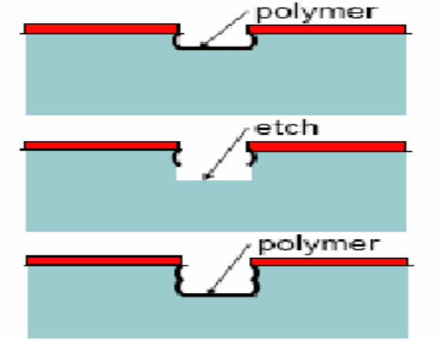
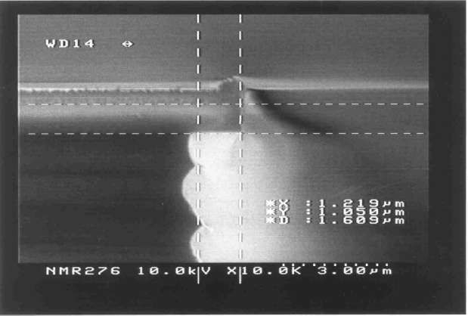
Microsystems STS Multiplex ICP:
‘Bosch™’ Process
‘Bosch™’ process is a pulsed, two-cycle etch
  Step 1 - SF₆ plasma which isotropically etches silicon
  Step 2 - C₄F₈ plasma which passivates the silicon surface
In the next cycle, SF_{x}⁺ ions accelerated towards wafer, removing polymer on horizontal surfaces leaving exposed Si.
F radicals from SF₆ plasma now etch down into exposed Si while vertical sidewalls protected by polymer. The pulses are repeated until the required etch depth is achieved
The sidewall profile is ‘scalloped’. The pulse parameters such as time, power etc. can be manipulated to give different sidewall profiles
Scalloping also means that the mask material is undercut by the etch.

Slide 15
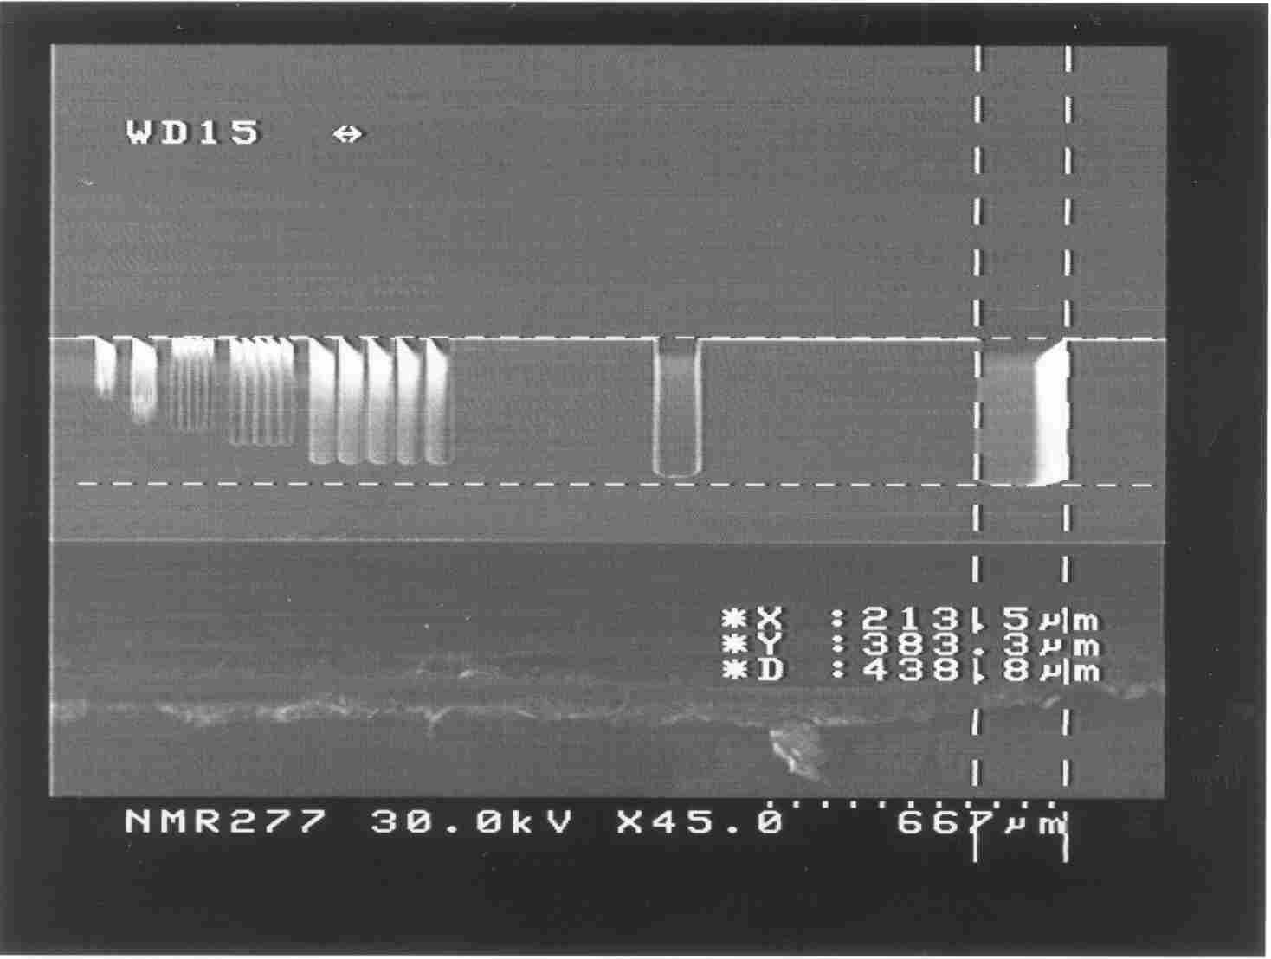
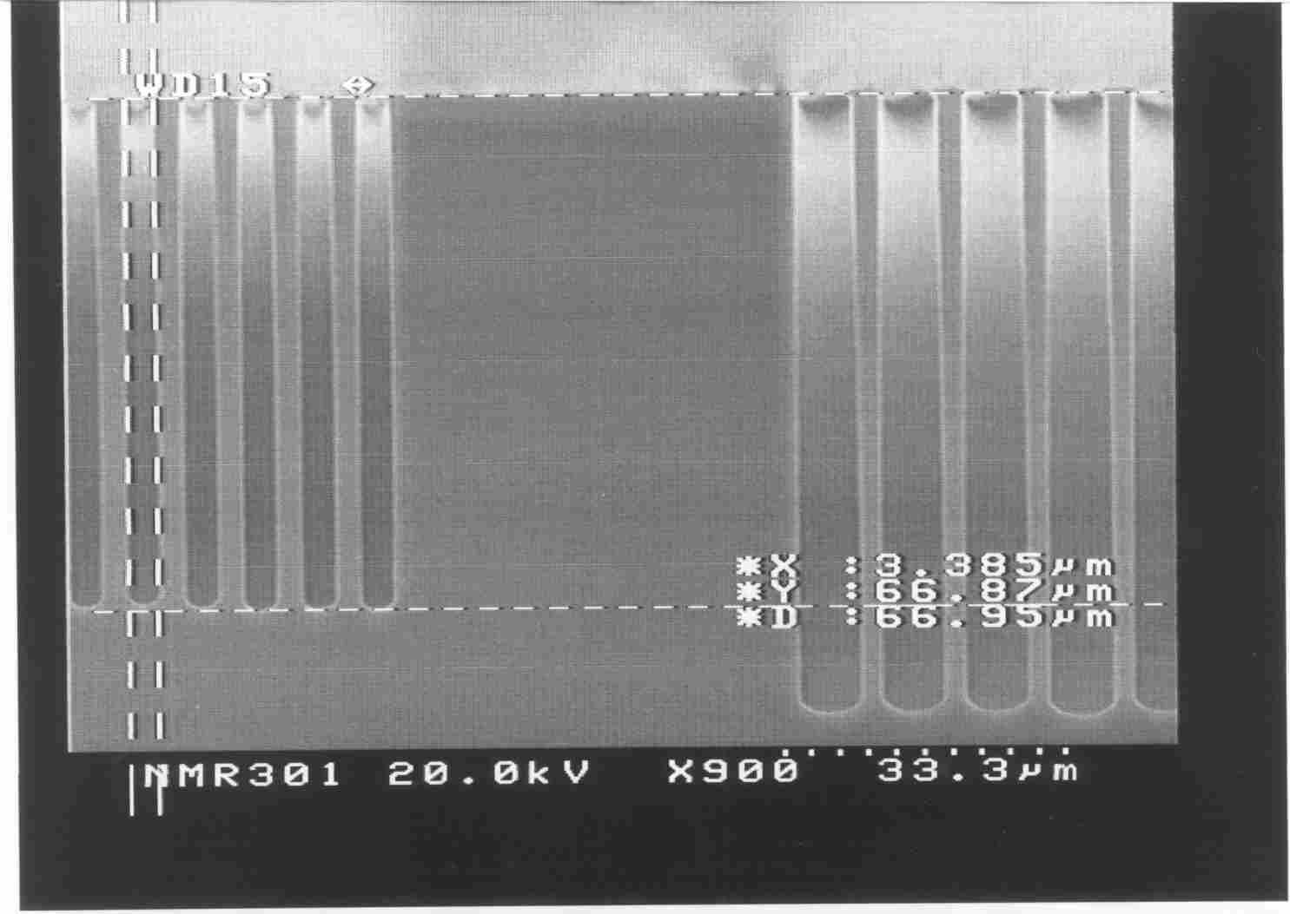
‘Bosch™’ Process Application:
Deep Silicon Trench Etching
Deep_1: through-wafer etch
53 mTorr, 9s etch / 2s passivate
High etch rates (7-10 μm/min)
Low AR (<20)
Large undercut (1 μm / 100 μm)
Larger scalloping with rough sidewalls
Vertical profile
Deep_3: small-geometry Trench-Etch
23 mTorr, 5s etch / 2s passivate
Lower etch rates (3-6 um/min)
High AR (>30)
Much lower undercut
Scalloping minimised, low sidewall roughness, suitable for optical MEMS
Vertical profile

Slide 16
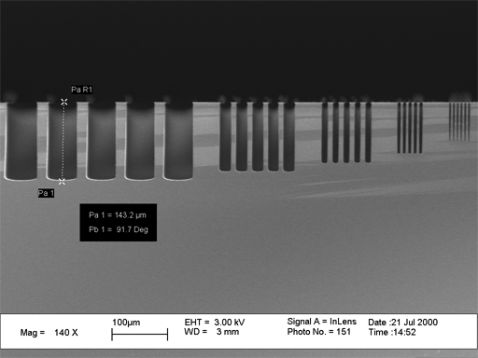
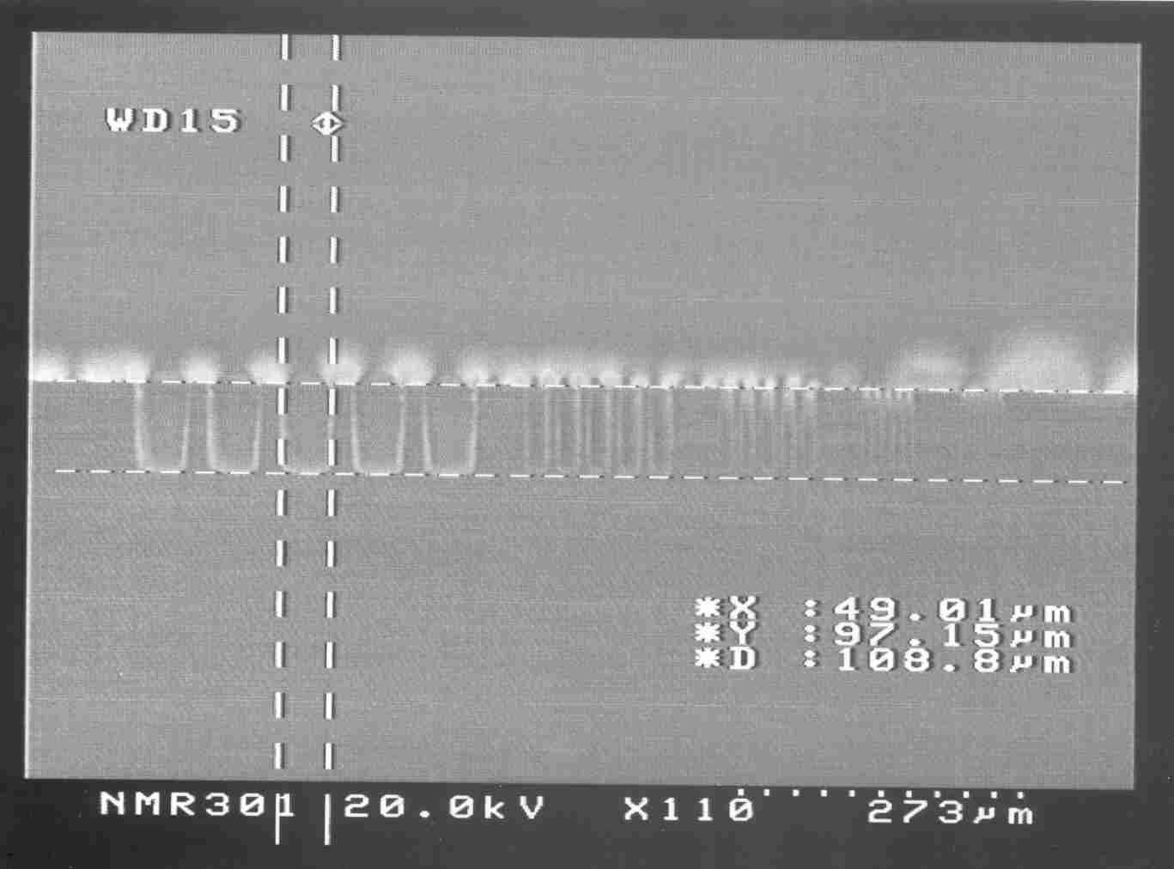
‘Bosch™’ Process:
Aspect Ratio Dependant Etching
ARDE is a feature of most plasma etch processes
  Smaller features etch slower than larger features
STS Multiplex can also run low-frequency power (380 kHz) to the lower electrode
Optimised ‘Bosch™’ process using pulsed low-frequency biasing on the lower electrode (instead of 13.56 MHz RF)
Deep_2: (38mTorr) 5s etch / 2s passivate using pulsed lf power (30W, 15ms/100ms)
Without ARDE, can now open varying geometry patterns at the same time on the wafer
‘Notching-free’ process for SOI applications allows the etch to stop on oxide layer, without lateral etching of the silicon pillars

Slide 17
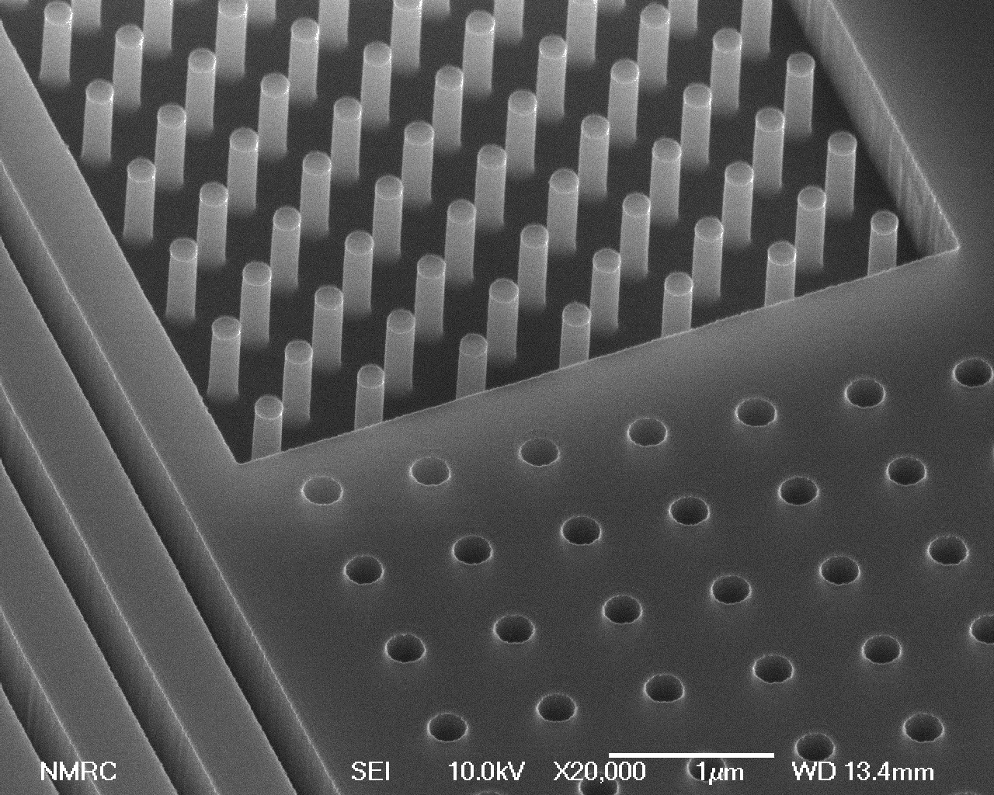
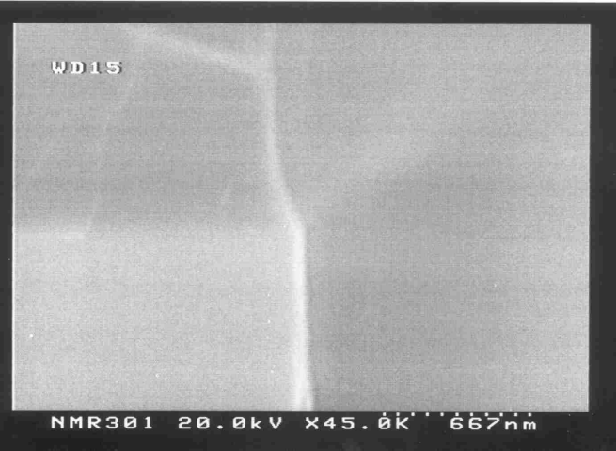
Microsystems STS Multiplex ICP Application:
Sub-Micron Silicon Etch
ICP etch process using continuous SF₆ / C₄F₈ plasma.
Etching and sidewall passivation occur at the same time
Etch rate ~ 1 μm/min
High selectivity to photoresist with no undercutting of the photoresist mask
Smooth sidewalls
Allows for deep etching of sub-micron features without the use of hard-mask layers
170nm diameter silicon pillars, etch depth 600nm
Interface between PR mask and Si shows no undercut

Slide 18
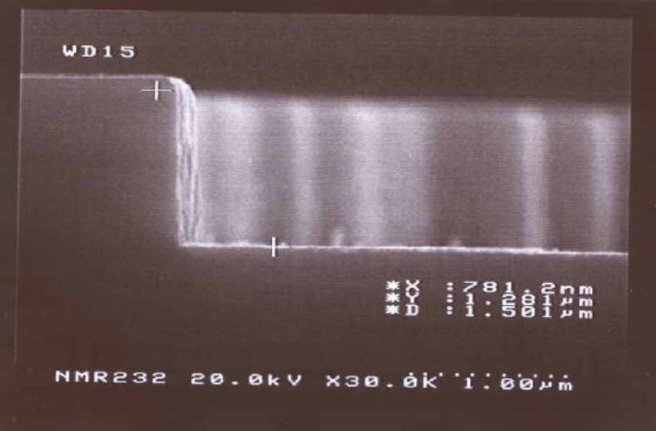
III-V STS Multiplex ICP Application:
Etching of InP
For photonics applications, such as lasers and LED’s, vertical edges are critical for efficient operation of the device
ICP etch process using Cl₂ / N₂ plasma, 5 mTorr pressue, 170ºC chuck temperature
Requires the use of an oxide hard-mask
Etch rate for InP ~ 350nm/min
Selectivity to PECVD oxide > 13:1
No ‘foot’ at bottom of sidewalls, this is a major development over existing technology

Slide 19
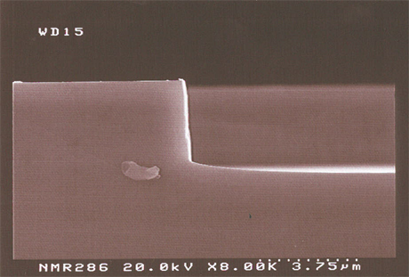
III-V STS Multiplex ICP Application:
Etching of GaAs / AlGaAs
As with InP, a vertical etch profile is required for GaAs for photonics applications
ICP etch process using BCl₃ plasma, 2.5 mTorr, 20ºC chuck temperature
Requires the use of an oxide hard-mask
Etch rate for GaAs ~ 250nm/min
Selectivity to PECVD oxide > 3:1
Small ‘foot’ at bottom of sidewalls, but much reduced compared to previous technology (RIE)

Slide 20
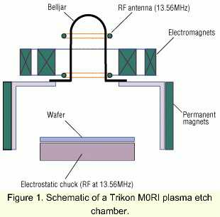
TRIKON M0RI:
(m=0 Resonant Induction)
Helicon or ‘whistler’ waves are waves which propagate in radially confined magnetised plasmas.
The RF antenna creates the helicon plasma in the bell-jar.
Inner electromagnet provides the magnetic field to produce the helicon wave
Outer electromagent is used to control plasma uniformity
Permanent magnets surround the aluminium chamber to minimise electron losses to the walls
Bias RF power applied to the wafer on the electrostatic chuck
Helicon mode creates very high-density plasma (~10¹² – 10¹³ cm⁻³) at pressures in the 1 – 25 mTorr range. This is typically a decade higher than other HDP sources

Slide 21
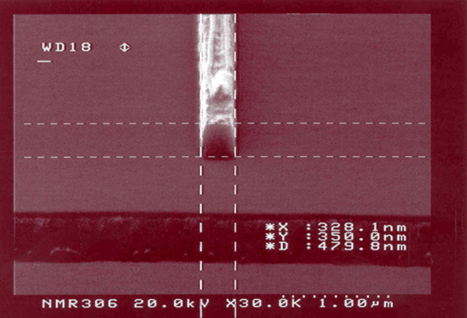
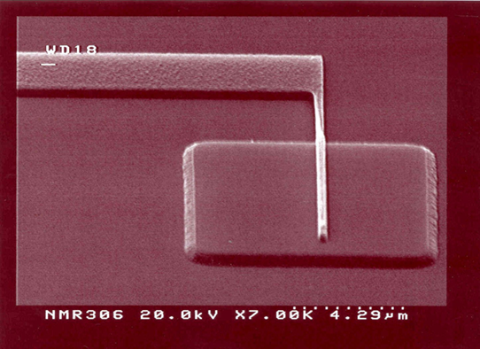
M0RI Application:
Sub-Micron Polysilicon Gates
SOI Device requires 3500A thick polysilicon gate on 100A gate oxide
Gate widths (CD) as small as 300nm are patterned using e-beam lithography (ZEP520 resist)
Require highly anisotropic etch with smooth sidewalls and very high selectivity to the underlying SiO₂
Bulk-etch: Cl₂/HBr plasma, 6 mTorr pressure, 15ºC chuck temperature
Over-etch: HBr/O₂ plasma, 10 mTorr pressure, 15ºC chuck temperature
Over-etch is highly selective to oxide (> 100:1)
SiO₂ loss is minimal (< 5 A)

Slide 22
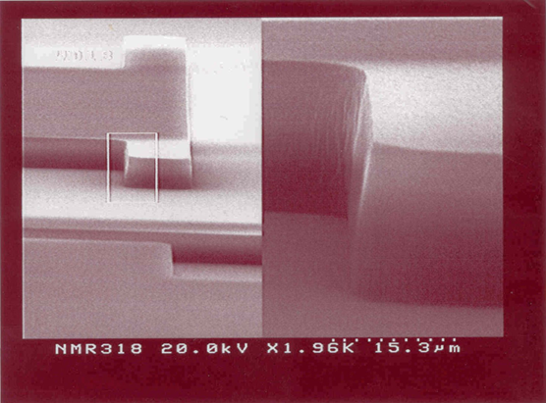
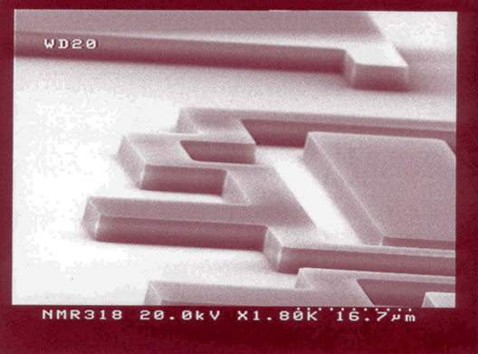
M0RI Application:
Oxide Etch for Waveguides
For waveguide applications, require a highly anisotropic etch with very smooth sidewalls for etch depths up to 10 μm
M0RI process using C₄F₈ / Ar plasma, very low pressure (2 mTorr), -15ºC chuck temperature
Etch Rate ~ 3000 A/min
Selectivity to photoresist > 2:1 with no undercut of mask
Final sidewall angle depends on initial photoresist profile
Excellent selectivity to underlying silicon, no micro-trenching at the foot of the sidewall

